Slide 1
DSCI 6007-2 Final Project – Showcase Team - 5
Promoting Transparent & Predictable Healthcare Costs for Students​
Date : 12/07/2025
Notes:
For Educators: You can use this template to help your students effectively present and communicate their project to a broader audience. Your students can also use this presentation as a portfolio of their work to demonstrate their cloud skills.
The presentation structure is listed below. The total time may vary depending on the activity you want to conduct. For example, you may want your students to provide high-level walkthrough of their final solutions versus deep-dive into why or how they chose certain services and the steps of building their architectures.
Suggested timing for a 15-minute presentation:
Introduction – 30 seconds
Business scenario overview – 1 minute
Solution overview – 5 minutes
Architecture diagram of the solution – 2 minutes
Demo – 5 minutes
Lessons learned – 1.5 minutes

Slide 2




TEAM
Deepak
Trinath
Satish
Kavya

Slide 3
Business scenario overview
Problem Statement:
Students often postpone medical treatment because healthcare pricing and insurance coverage are not clearly communicated. This lack of transparency creates financial anxiety and undermines their willingness to seek necessary care. To address this, an automated platform is required to deliver predictable and transparent cost estimates for student healthcare.
Solution Requirements:
Automated Data Pipeline : Provides continuous, hands-free data ingestion and processing.
Data Cleaning and Integration, Centralized Data Storage
Query and Analysis : enables fast querying and insight generation from processed data.
Interactive Dashboard , User Accessibility
Scalability and Maintenance : Supports growth and remains simple to update and manage.
Notes:
Define the problem or opportunity that you are addressing. Include pictures, figures, and statistics to help the audience better conceptualize the problem or opportunity.
Specify who your users or customers are and what pain points they are experiencing.
For example: “Users complain that the student admissions department website is too slow and isn’t always available.”
Also, list any specific business requirements that you are addressing.
For example: “Improve the experience for users. The web application can be deployed to the AWS Cloud. The application must be highly available, scalable, load balanced, secure, and performant architecture that can support thousands of users.“
Note:
An above-bar overview succinctly defines the problem and opportunity statement. For example: “Customers with media files, such as retail companies, need an easy and cost-effective way to analyze photos and videos of their inventory.”
A below-bar overview is too verbose, technical, or not specific. For example: “The most common media files are .jpg and .mp4. Companies have media files of their inventory.”

Slide 4
Solution overview
High-Level Solution:
Automated AWS-based pipeline processes healthcare claims data end-to-end.
Converts raw CSV uploads into clean, queryable datasets.
Real-time dashboards in Power BI help international students understand healthcare costs.
Design Considerations:
Automation: Event-driven ETL with S3, Glue, and Athena.
Usability: Simple, non-technical dashboards for students.
Scalability: Supports high data volume & future ML integration.
Data Quality: Cleansing ensures valid, consistent, and accurate info
Use Cases:
Understand total paid claims and out-of-pocket trends.
Identify top providers and common diagnoses.
Support budget planning and cost comparison.
Enable predictive analytics (Ex: fraud detection) in the future.
Notes:
Explain at a high level what you have built.
For example: “I built a web application for a company to host their blog.“
Talk about why you chose certain parts of the solutions and any tradeoffs that you made. Focus on how you designed the solutions and how you applied the AWS Well-Architected Framework as part of the process (AWS Well-Architected Framework: https://docs.aws.amazon.com/wellarchitected/latest/framework/welcome.html).
For example: “I configured load balancers and auto scaling to make the application highly available and reliable.”
Include the use cases that you are addressing. Think about who your users are and how they would want to interact with your solution to solve their problem.
For example: “Users can view, upload, edit, and delete blog posts. Administrators can approve blog posts.”
Talk about the use cases that you addressed as part of the minimum viable product (MVP) that you scoped and built.
Note:
An above-bar description is concise and includes the most important benefits. For example: “The solution allows customers to quickly upload, store, and search large catalogs of images and videos in Amazon S3.”
A below-bar description is too detailed or not specific. For example: “Our solution analyzes media files.”

Slide 5
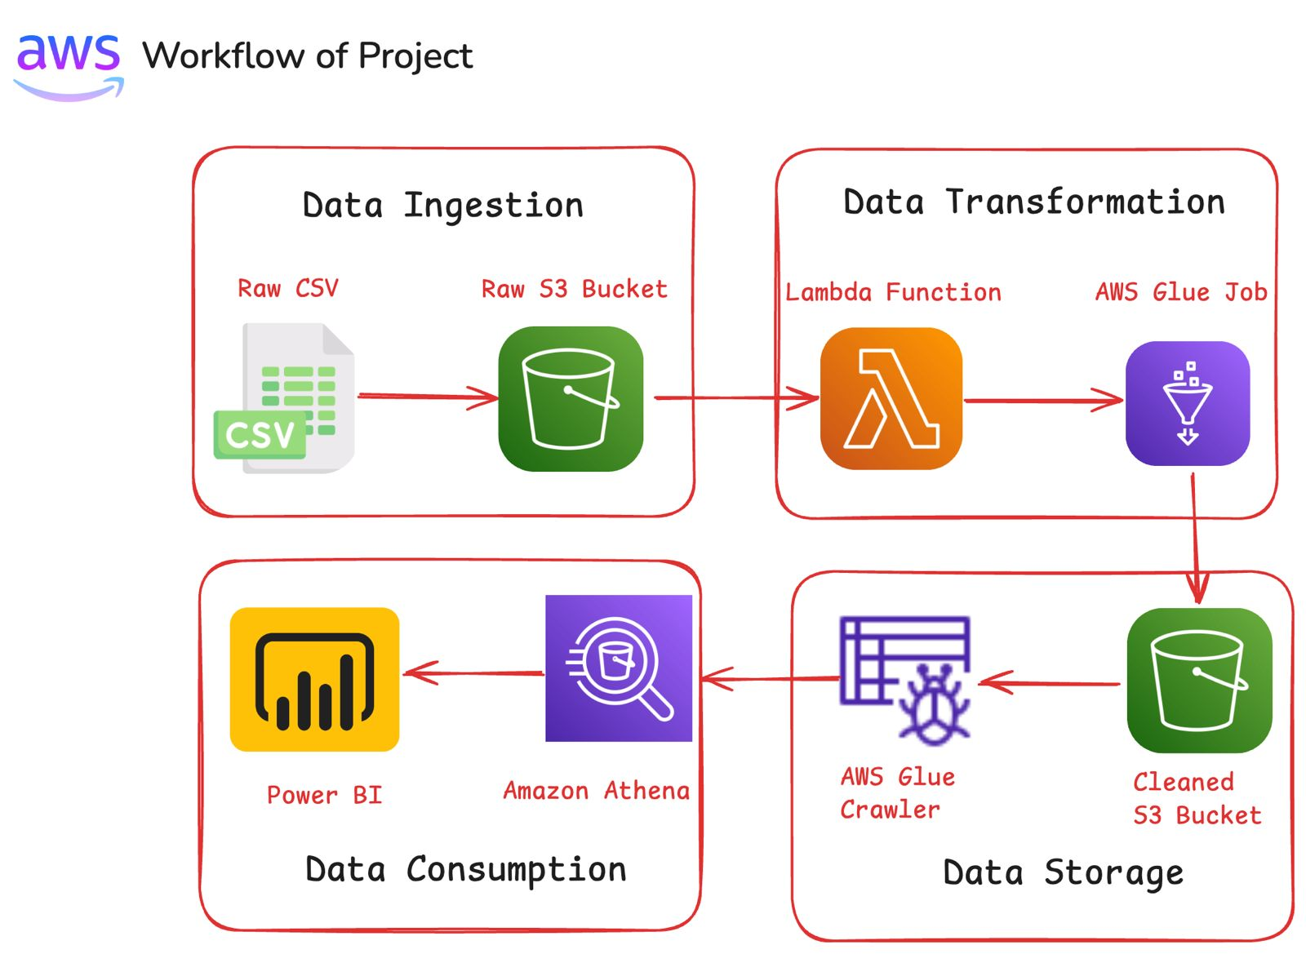
Architecture diagram of the solution
Notes:
Use the following resources to create a diagram of your application architecture:
AWS Architecture Icons at https://aws.amazon.com/architecture/icons. This page includes diagram assets as well as links to drawing and diagramming tools that you can use.
As you walk through the architecture, make sure that you relate back to the business requirements and the AWS Well-Architected Framework (https://docs.aws.amazon.com/wellarchitected/latest/framework/welcome.html).
You can also go more in depth about the design considerations and trade-offs that you made.

Slide 6
Lessons learned
Challenges:
Difficult to get Health care data due hipaa laws.
Data Quality Issues: Incomplete, inconsistent, or invalid entries in raw claims data.
Healthcare Complexity: Difficult to simplify terms like co-pays, deductibles, or insurance coverage.
Integration between AWS Glue, Athena, and Power BI.
Scalability: Designing a pipeline that can handle future data growth and real-time processing
Helpful Resources:
AWS documentation, tutorials, community forums, Stack Overflow.
CRISP-DM methodology.
Power BI tutorials.
Teaching Assistant AWS classes.
Notes:
Describe any challenges that you encountered and how you overcame those challenges.
For example: “I got stuck when I was creating an EC2 instance to host the application. I used the resources that were listed in the instructions to walk myself through the process to create a new EC2, and I was able to complete the task. The links to labs in other courses were very helpful.”
Describe any new skills that you learned from this project.
For example: “I learned how to set up auto scaling correctly so my resources were automatically adjusted and allocated at the lowest possible cost.”
Discuss any future, out-of-scope use cases in the next steps.
For example: “I would like to scale out the web application so that multiple departments can use it.”

Slide 7
Lessons learned
Skills Gained and Next Steps
New Skills Gained:
Use of AWS services like S3, Glue, Athena, Crawler, etc.
Data pipeline automation.
Power BI integration.
CRSIP-DM methodology.
Next Steps:
Implement real-time data processing.
Explore additional AWS services (Lambda, QuickSight).
Enable predictive analytics (e.g., fraud detection).
Notes:
Describe any challenges that you encountered and how you overcame those challenges.
For example: “I got stuck when I was creating an EC2 instance to host the application. I used the resources that were listed in the instructions to walk myself through the process to create a new EC2, and I was able to complete the task. The links to labs in other courses were very helpful.”
Describe any new skills that you learned from this project.
For example: “I learned how to set up auto scaling correctly so my resources were automatically adjusted and allocated at the lowest possible cost.”
Discuss any future, out-of-scope use cases in the next steps.
For example: “I would like to scale out the web application so that multiple departments can use it.”

Slide 8
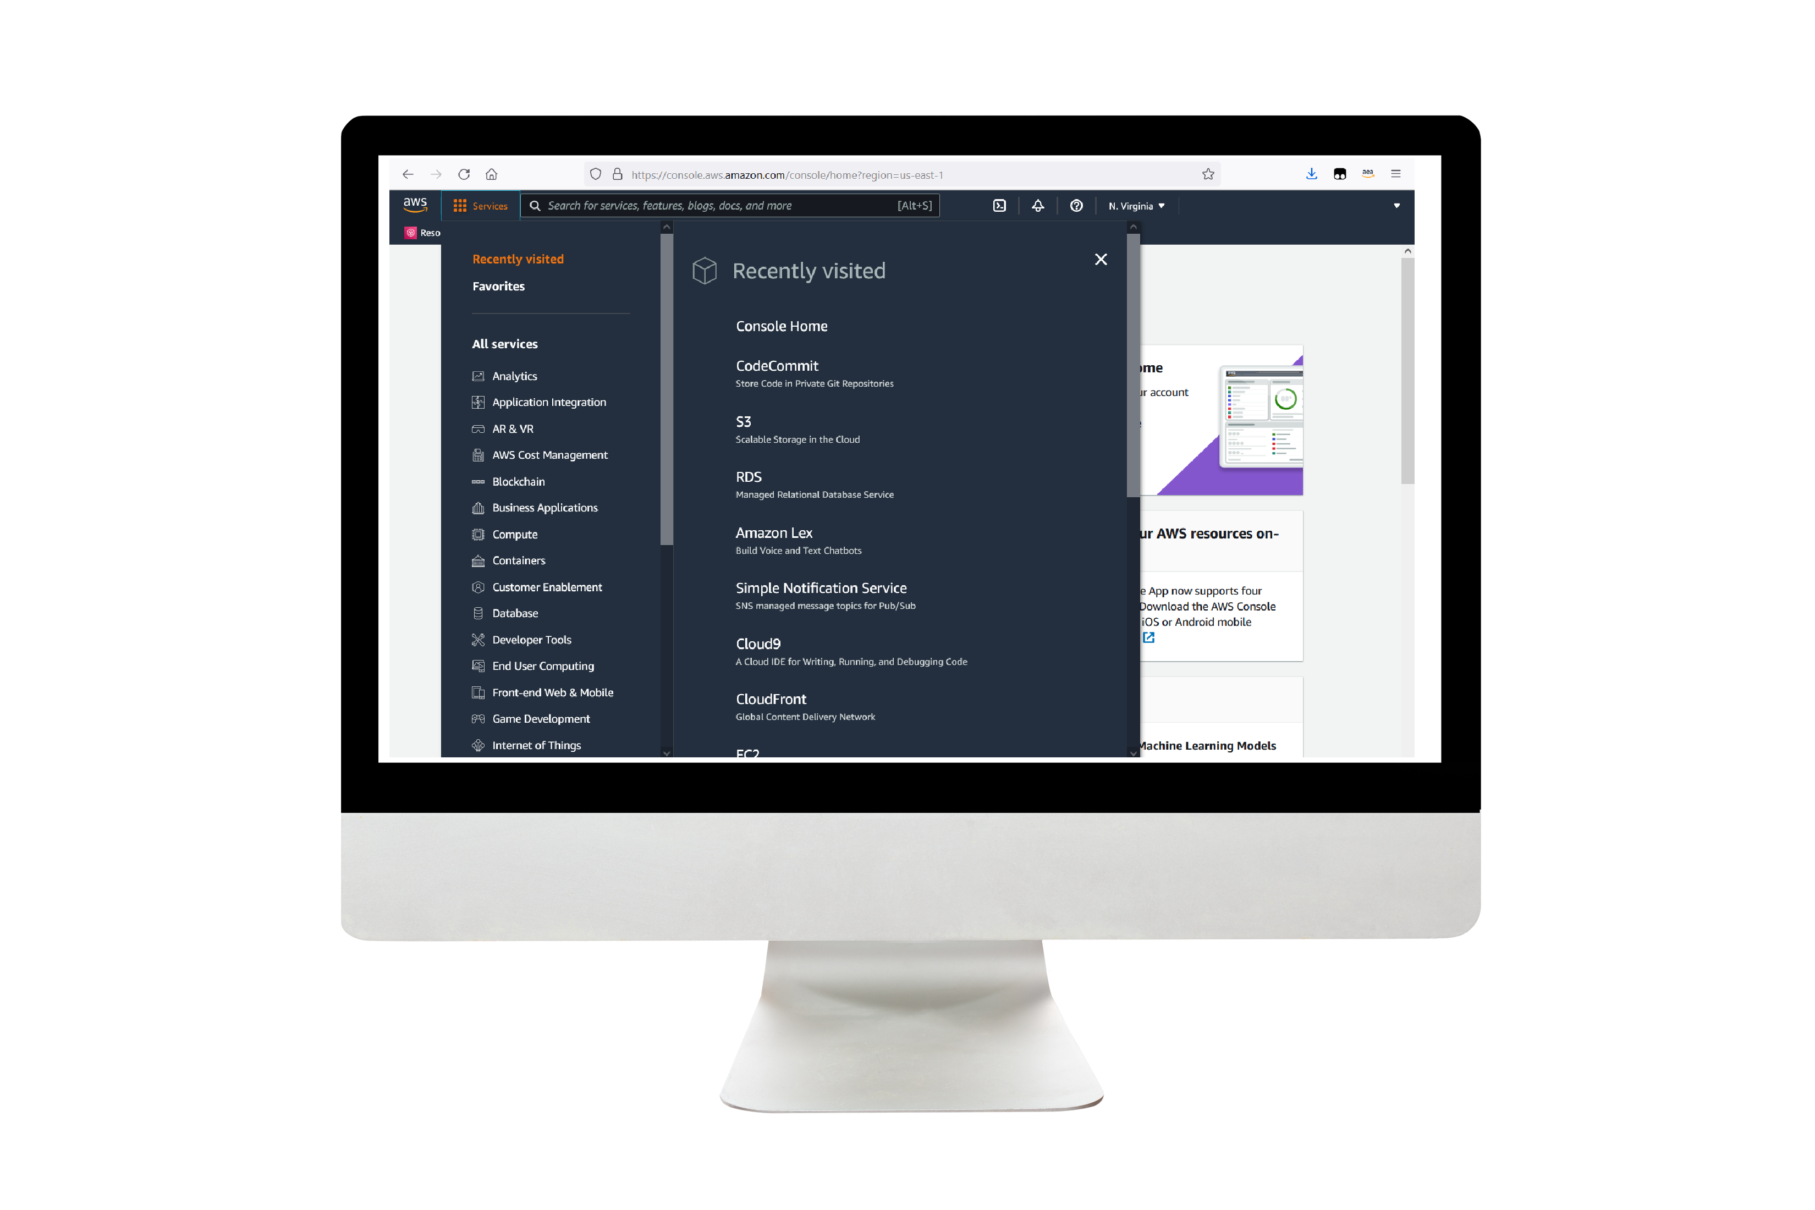
Demo
Notes:
For the demo, guide the audience through the two to three most important benefits of the solution and how it addresses the requirements.
Your demo materials can be screen captures, recordings, a link to your final solution, and/or a link to AWS console.

Slide 9
Thank you

